Slide 1


Simple Harmonic Motion, The force law of SHM, Angular SHM
Chapter 15: Oscillation

Slide 2
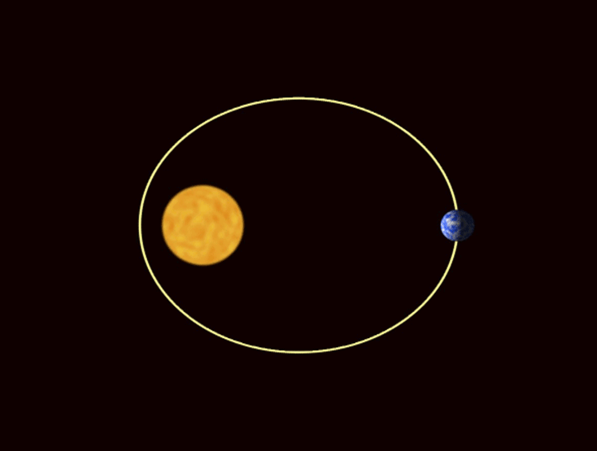

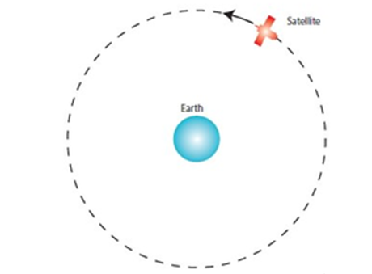
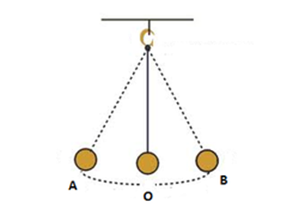
Periodic Motion
“The motion repeated in equal intervals of time”
Examples:
a rocking chair
a bouncing ball
a vibrating tuning fork
a swing in motion
the Earth in its orbit around the Sun

Slide 3
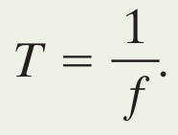
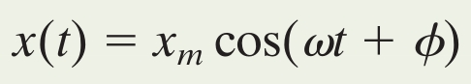
15-1 Simple Harmonic Motion
The frequency of an oscillation is the number of times per second that it completes a full oscillation (cycle)
Unit of hertz: 1 Hz = 1 oscillation per second
The time in seconds for one full cycle is the period
Any motion that repeats regularly is called periodic
Simple harmonic motion is periodic motion that is a sinusoidal function of time
Eq. (15-2)
Eq. (15-3)
Notes:
3

Slide 4
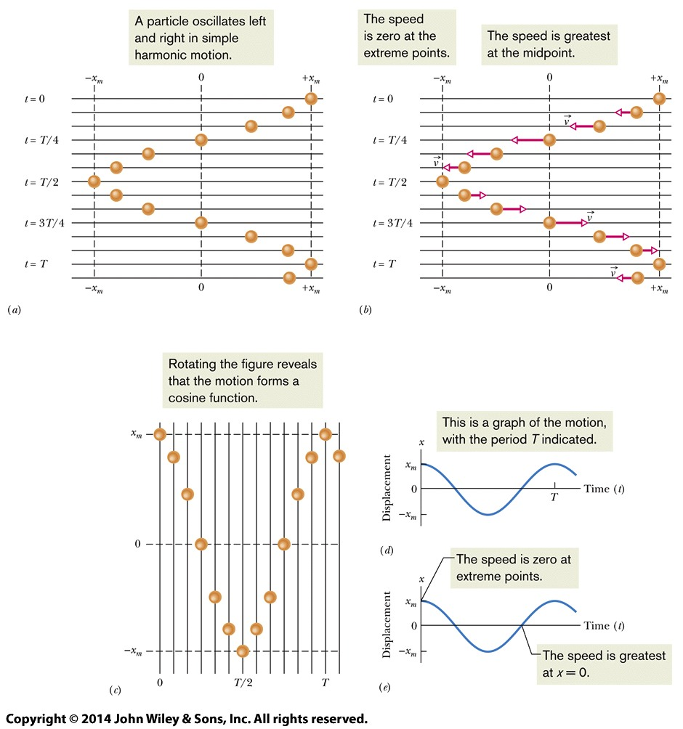
15-1 Simple Harmonic Motion
Figure 15-2
Notes:
4

Slide 5
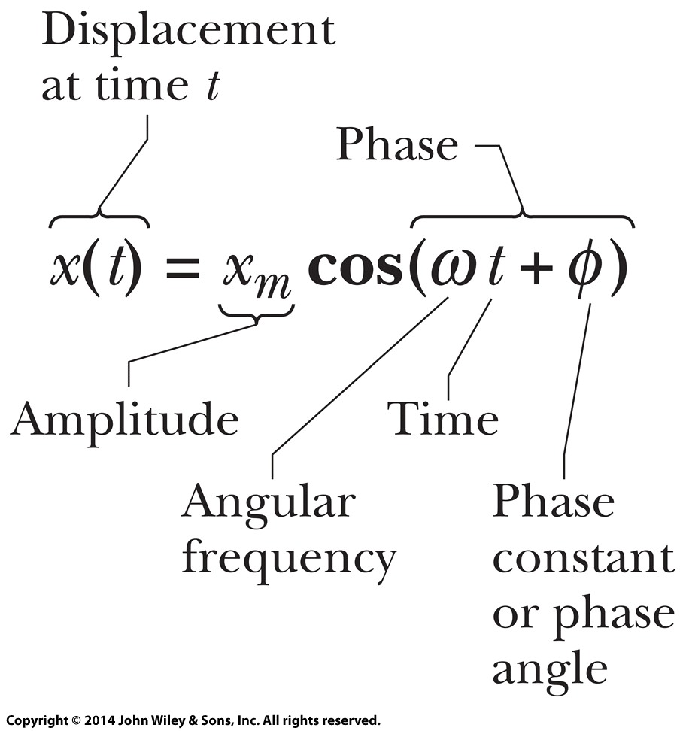
15-1 Simple Harmonic Motion
The value written x_{m} is how far the particle moves in either direction: the amplitude
The argument of the cosine is the phase
The constant φ is called the phase angle or phase constant
It adjusts for the initial conditions of motion at t = 0
The angular frequency is written ω
Figure 15-3
Notes:
5

Slide 6
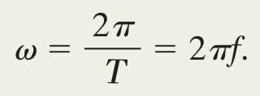
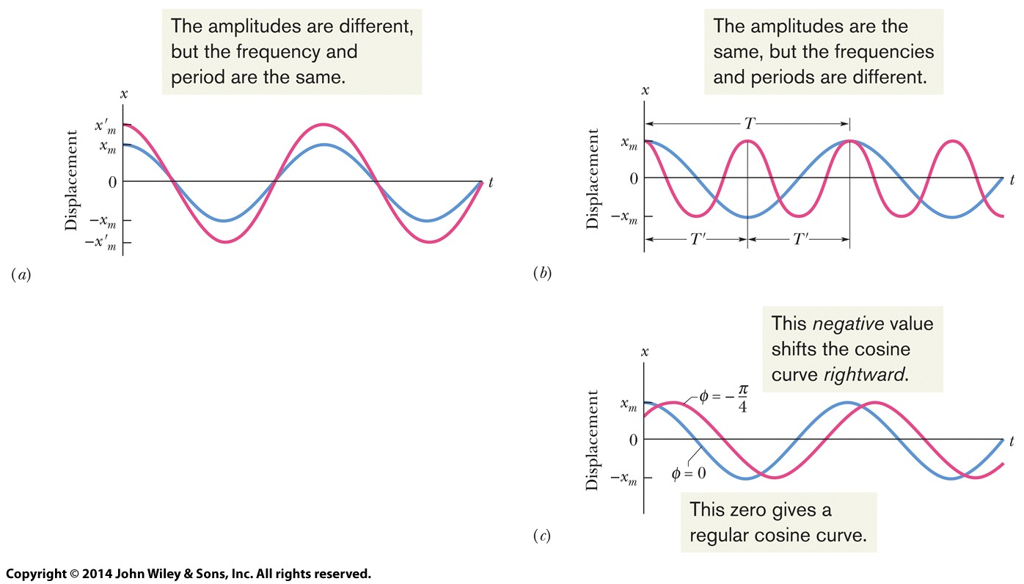
15-1 Simple Harmonic Motion
The angular frequency has the value:
Eq. (15-5)18
Figure 15-5
Notes:
6

Slide 7
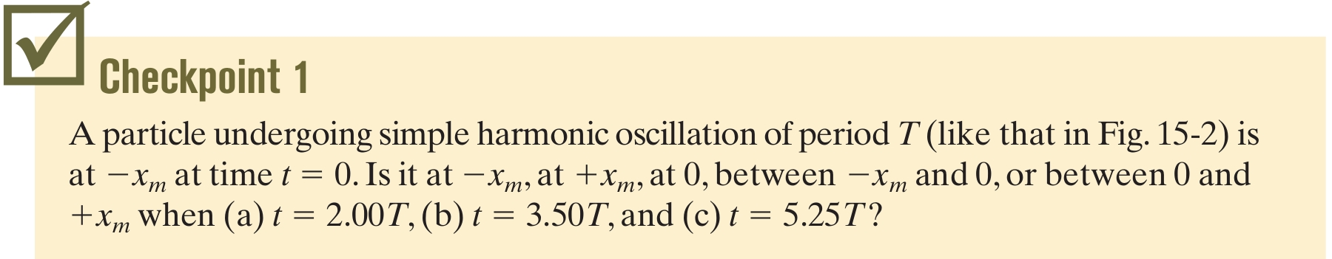
15-1 Simple Harmonic Motion
The velocity can be found by the time derivative of the position function:
The value ωx_{m} is the velocity amplitude v_{m}
Eq. (15-6)18
Notes:
7

Slide 8
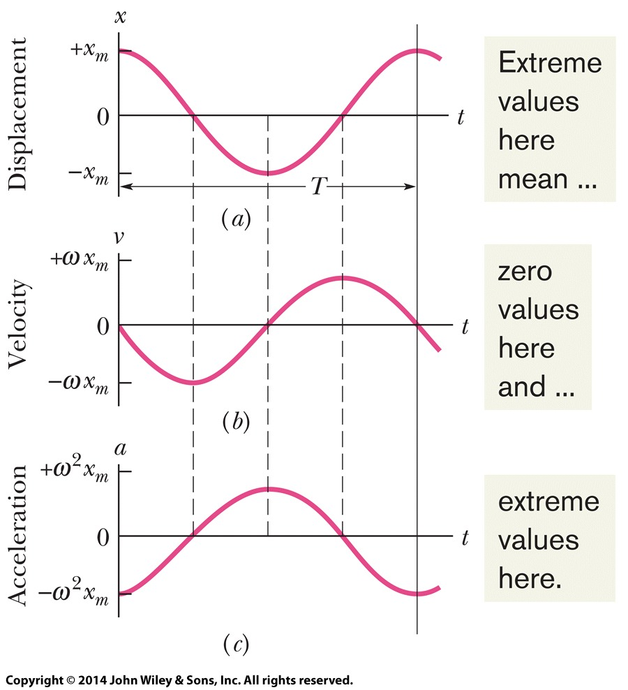
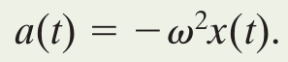
15-1 Simple Harmonic Motion
The acceleration can be found by the time derivative of the velocity function, or 2nd derivative of position:
The value ω²x_{m} is the acceleration amplitude a_{m}
Acceleration related to position:
Eq. (15-7)18
Eq. (15-8)18
Figure 15-6
Notes:
8

Slide 9
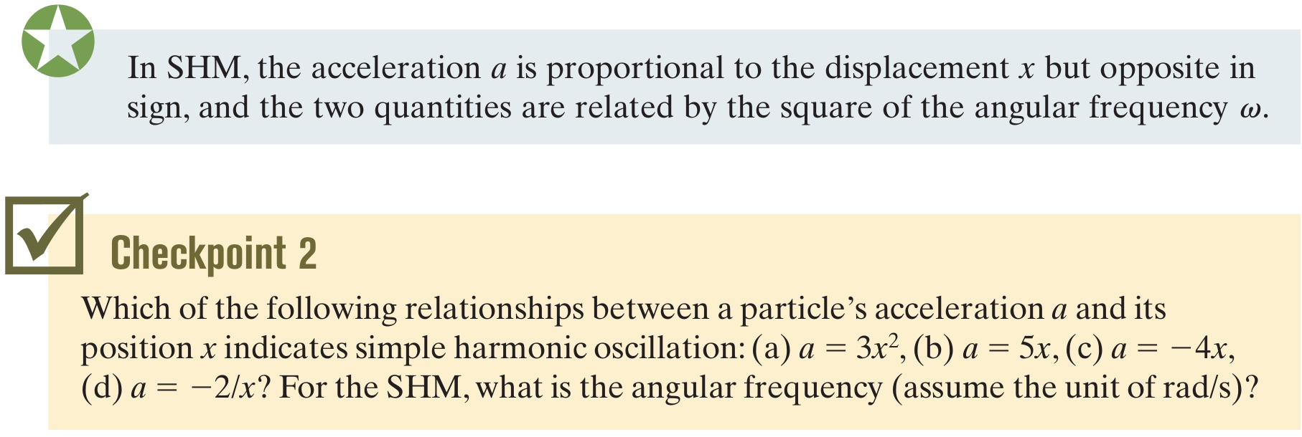
15-1 Simple Harmonic Motion
Notes:
9

Slide 10
Answer: (c) where the angular frequency is 2

Slide 11

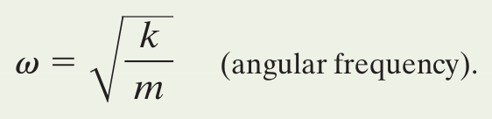
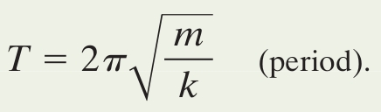
15-1 Simple Harmonic Motion
We can apply Newton's second law
Relating this to Hooke's law we see the similarity
Linear simple harmonic oscillation (F is proportional to x to the first power) gives:
Eq. (15-9)18
Eq. (15-12)18
Eq. (15-13)18
Notes:
11
Mass spring system called the linear simple harmonic oscillator or linear oscillator

Slide 12
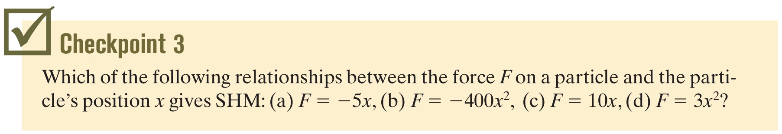
15-1 Simple Harmonic Motion
Notes:
12

Slide 13
Answer: only (a) is simple harmonic motion
(note that b is harmonic motion, but nonlinear and not SHM)

Slide 16
15-2 Energy in Simple Harmonic Motion
Learning Objectives
15.19 For a spring-block oscillator, calculate the kinetic energy and elastic potential energy at any given time.
15.20 Apply the conservation of energy to relate the total energy of a spring-block oscillator at one instant to the total energy at another instant.
15.21 Sketch a graph of the kinetic energy, potential energy, and total energy of a spring-block oscillator, first as a function of time and then as a function of the oscillator's position.
15.22 For a spring-block oscillator, determine the block's position when the total energy is entirely kinetic energy and when it is entirely potential energy.
Notes:
16

Slide 17
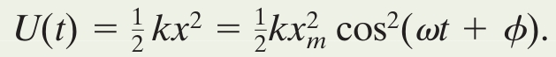
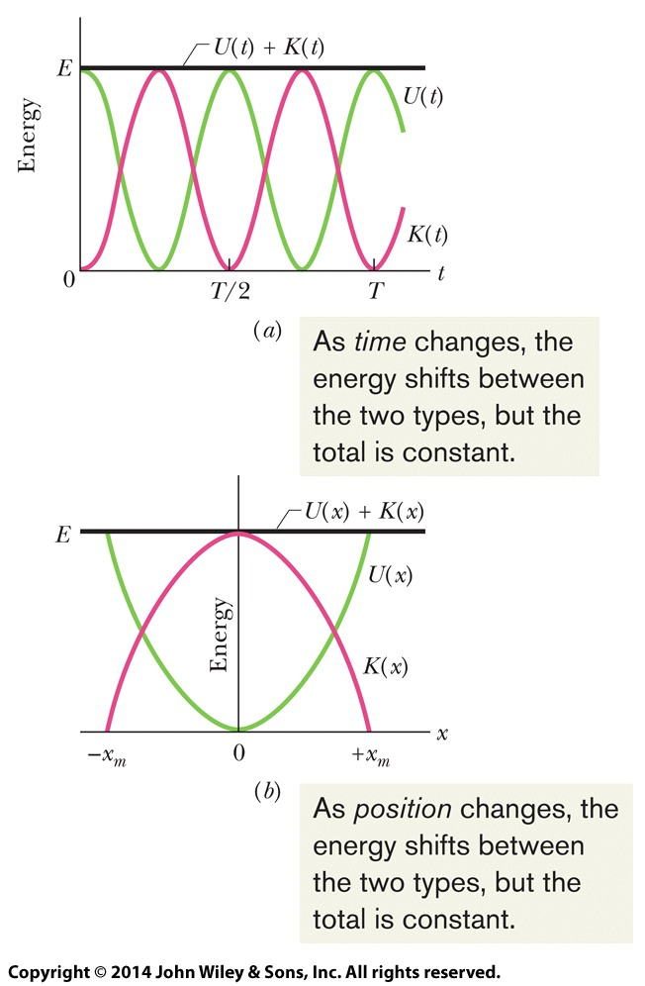
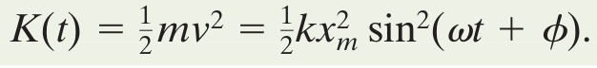
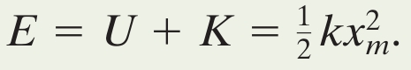
15-2 Energy in Simple Harmonic Motion
Write the functions for kinetic and potential energy:
Their sum is defined by:
Eq. (15-18)18
Eq. (15-20)18
Eq. (15-21)18
Figure 15-8
Notes:
17

Slide 18
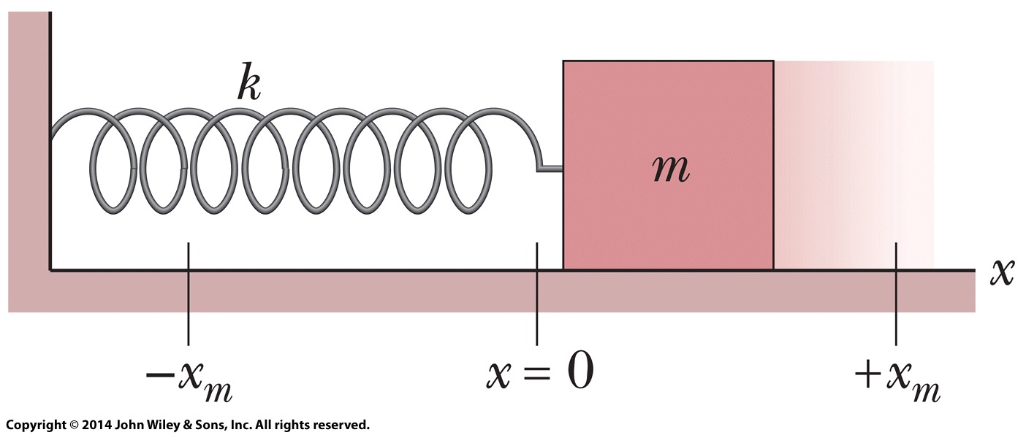
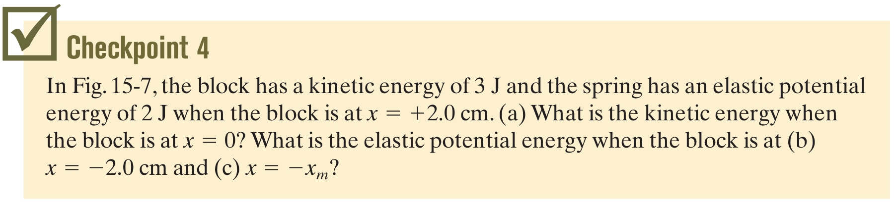
15-2 Energy in Simple Harmonic Motion
Figure 15-7
Notes:
18

Slide 19
15-3 AN ANGULAR SIMPLE HARMONIC OSCILLATOR
15.23 Describe the motion of an angular simple harmonic oscillator.
15.24 For an angular simple harmonic oscillator, apply the relationship between the torque τ and the angular displacement θ (from equilibrium).
15.25 For an angular simple harmonic oscillator, apply the relationship between the period T (or frequency f ), the rotational inertia I, and the torsion constant k.
15.26 For an angular simple harmonic oscillator at any instant, apply the relationship between the angular acceleration a, the angular frequency ω, and the angular displacement θ.

Slide 20
15-3 AN ANGULAR SIMPLE HARMONIC OSCILLATOR
Torsion Pendulum
Here k (Greek kappa) is a constant, called the torsion constant,
that depends on
the length
diameter
material of the suspension wire

Slide 21

15-4 PENDULUMS, CIRCULAR MOTION
The Simple Pendulum
The Restoring Torque.
Pivot point
where the minus sign indicates that the torque acts to reduce θ
As an example, if θ = 5.00^{ᵒ} =0.0873 rad, then sinθ = 0.0872, a difference of only about 0.1%.
The angular amplitude θ_{m} of the motion (the maximum angle of swing) must be small.

Slide 22
15-4 PENDULUMS, CIRCULAR MOTION
Angular Frequency
Period

Slide 23
15-4 PENDULUMS, CIRCULAR MOTION

Slide 24
15-4 PENDULUMS, CIRCULAR MOTION
Position
The projection of particle P’ onto the x axis is a point P, which we take to be a second particle.
The projection of the position vector of particle P’ onto the x-axis gives the location x(t) of P.

Slide 25
15-4 PENDULUMS, CIRCULAR MOTION
Velocity
The magnitude of the velocity vector is ωx_{m}; its projection on the x axis is
Acceleration
The magnitude of the radial acceleration vector is ω²x_{m}; its projection on the x axis is

Slide 26
15-5 Damped Simple Harmonic Motion
Learning Objectives
15.38 Describe the motion of a damped simple harmonic oscillator and sketch a graph of the oscillator's position as a function of time.
15.39 For any particular time, calculate the position of a damped simple harmonic oscillator.
15.40 Determine the amplitude of a damped simple harmonic oscillator at any given time.
15.41 Calculate the angular frequency of a damped simple harmonic oscillator in terms of the spring constant, the damping constant, and the mass, and approximate the angular frequency when the damping constant is small.
15.42 Apply the equation giving the (approximate) total energy of a damped simple harmonic oscillator as a function of time.
Notes:
26

Slide 27
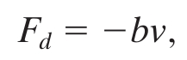
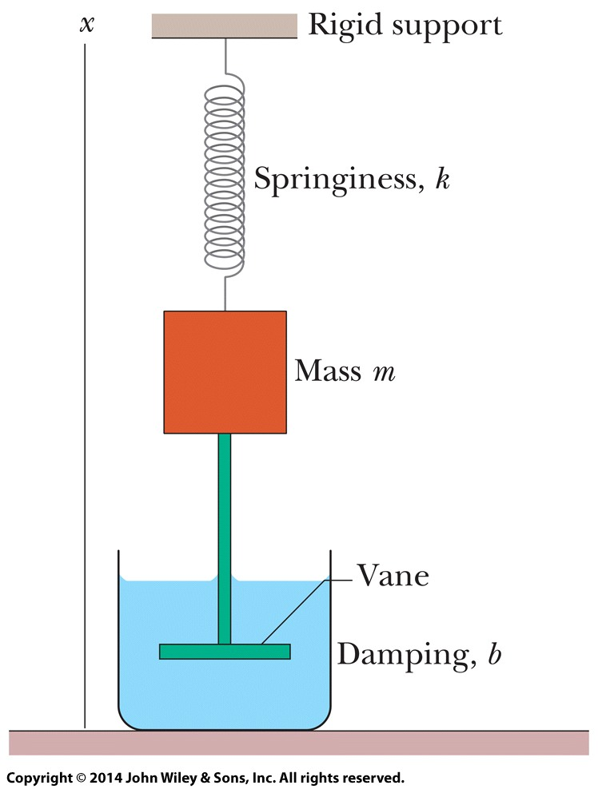
15-5 Damped Simple Harmonic Motion
When an external force reduces the motion of an oscillator, its motion is damped
Assume the liquid exerts a damping force proportional to velocity (accurate for slow motion)
b is a damping constant, depends on the vane and the viscosity of the fluid
Eq. (15-39)
Figure 15-16
Notes:
27

Slide 28
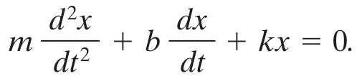
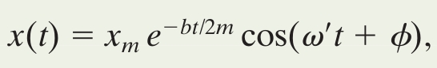
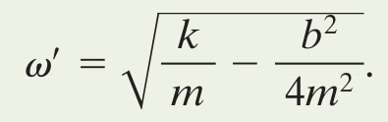
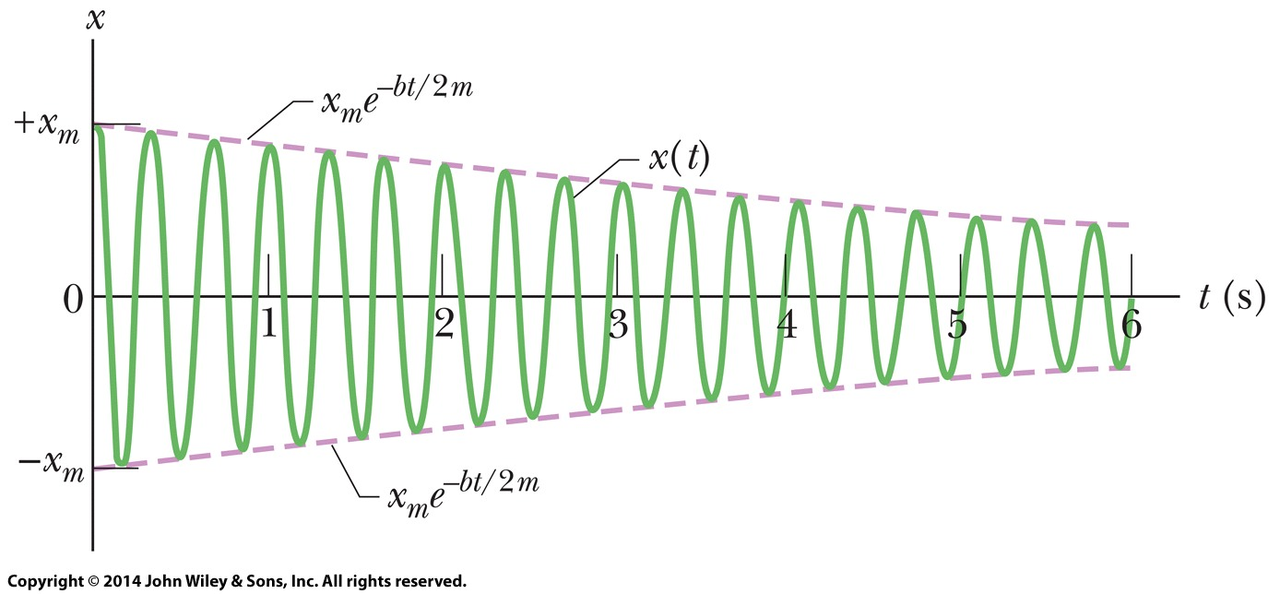
15-5 Damped Simple Harmonic Motion
We use Newton's second law and rearrange to find:
The solution to this differential equation is:
With angular frequency:
Eq. (15-41)
Eq. (15-42)
Eq. (15-43)
Figure 15-17
Notes:
28

Slide 29
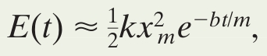
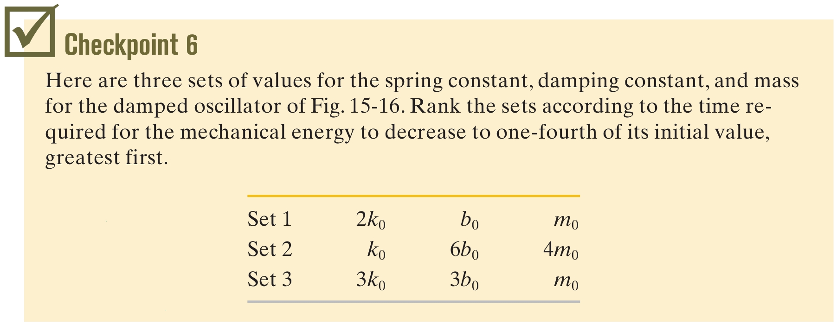
15-5 Damped Simple Harmonic Motion
If the damping constant is small, ω' ≈ ω
For small damping we find mechanical energy by substituting our new, decreasing amplitude:
Eq. (15-44)
Answer: 1,2,3
Notes:
29

Slide 30
15-6 Forced Oscillations and Resonance
Learning Objectives
15.43 Distinguish between natural angular frequency and driving angular frequency.
15.44 For a forced oscillator, sketch a graph of the oscillation amplitude versus the ratio of the driving angular frequency to the natural angular frequency, identify the approximate location of resonance, and indicate the effect of increasing the damping.
15.45 For a given natural angular frequency, identify the approximate driving angular frequency that gives resonance.
Notes:
30

Slide 31
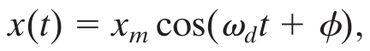
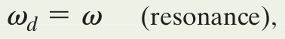
15-6 Forced Oscillations and Resonance
Forced, or driven, oscillations are subject to a periodic applied force
A forced oscillator oscillates at the angular frequency of its driving force:
The displacement amplitude is a complicated function of ω and ω₀
The velocity amplitude of the oscillations is greatest when:
Eq. (15-45)
Eq. (15-46)
Notes:
31

Slide 32
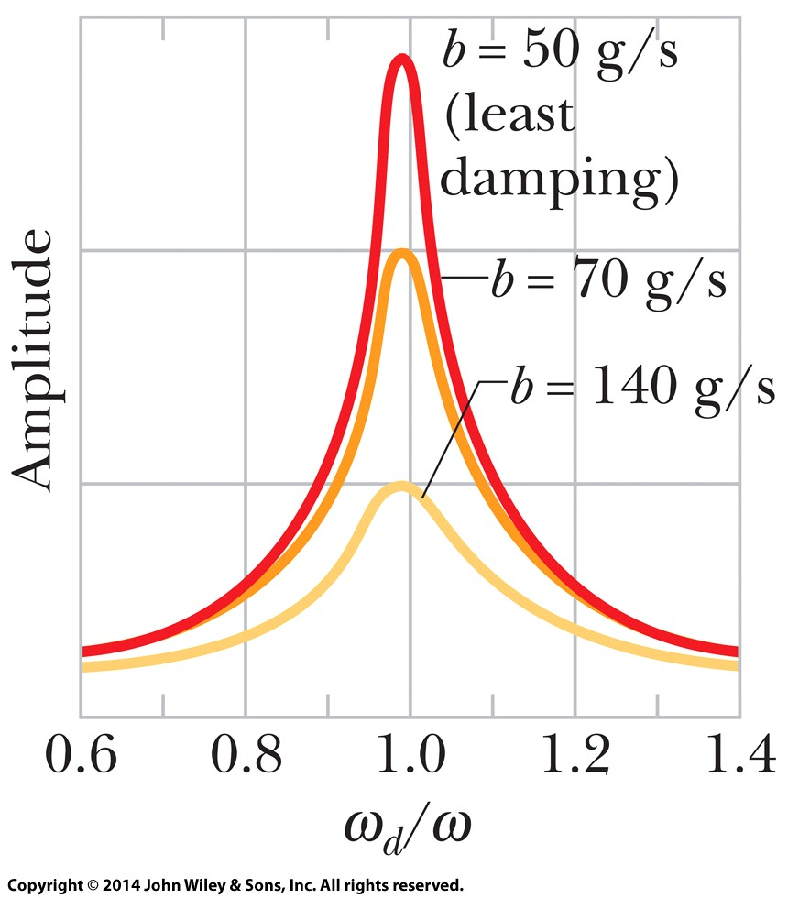
15-6 Forced Oscillations and Resonance
This condition is called resonance
This is also approximately when the displacement amplitude is largest
Resonance has important implications for the stability of structures
Forced oscillations at resonant frequency may result in rupture or collapse
Figure 15-18
Notes:
32

Slide 33
15 Summary
Frequency
1 Hz = 1 cycle per second
Simple Harmonic Motion
Find v and a by differentiation
Period
Eq. (15-3)
Eq. (15-2)
Eq. (15-5)
The Linear Oscillator
Energy
Mechanical energy remains constant as K and U change
K = ½ mv², U = ½ kx²
Eq. (15-12)
Eq. (15-13)
Notes:
33

Slide 34
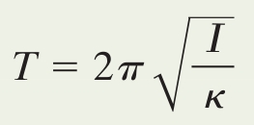
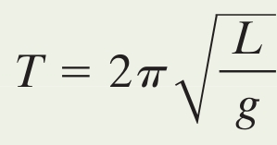
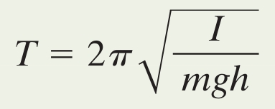
15 Summary
Pendulums
Simple Harmonic Motion and Uniform Circular Motion
SHM is the projection of UCM onto the diameter of the circle in which the UCM occurs
Eq. (15-23)
Eq. (15-28)
Eq. (15-29)
Damped Harmonic Motion
Forced Oscillations and Resonance
The velocity amplitude is greatest when the driving force is related to the natural frequency by:
Eq. (15-42)
Eq. (15-43)
Eq. (15-46)
Notes:
34

Slide 35
https://www.youtube.com/watch?v=cx-qHZwsLqs
https://www.animations.physics.unsw.edu.au/jw/SHM.htm

